Slide 1

Artyfy
By:-
ASE Project Team – 5
Instructor: Dr. Aznam Yacoub
Customer – Hardik Yogesh Sonneta
Project Director – Samaneh Mirirostami

Slide 2
OUR TEAM
NAME TENTATIVE ROLES
Yuva Venkata Sai Duppati Full Stack Developer, Scrum Master
Bhargav Sai Karicheti Full Stack Developer
Shruthi Paka Full Stack Developer
Lakshmi Vardhani Pravallika Munukutla Full Stack Developer
Lakshmi Narayanan Shankar Full Stack Developer
Nupur Badiani Full Stack Developer
Deepaksai Valluru Full stack Developer
Varun Ahuja Full Stack Developer

Slide 3

PrOBLEM’S AND NEEDS
This epidemics of Covid has impacted every component on earth and art business is one of them. This disappoints most of the art lovers who are enthusiastic towards finding art. In a similar way, artists who want to showcase their art are also being burdened by the restrictions imposed as the art galleries and museums which are not considered as essential services.
Our application exhibit nearby museums and list of total artists who are registered to showcase their art and sculptures to the art lovers and to general public.
This Mobile application remove the barrier of restrictions imposed on people and let them relish over the art presented by different artists or artistic places.

Slide 4
Purpose and Scope
The purpose of our project is to develop a high-end, user-friendly, cost-effective Gallery and Art Management engine that helps intended target users to keep track of all the local galleries, Museums, Artists and Art exhibitions.
This software bridges the existing artistic platforms (Arts Gallery’s & Artists) and can create new marked space for the Art lovers.
The Art finder application will use image and pattern recognition techniques to classify the paintings based on the Art Style. This will help the students as well as the museum staffs to group the various paintings into the required category, by just uploading the image of the art.
The scope of this project is to develop an authentic android application that is used for Artists or Art gallery owners to showcase their arts and sell their arts, respectively. The application can also use for search nearby art galleries or museums. The project will also allow users to view or purchase all categories of arts available

Slide 5

How will this help the university
Our project is deeply connected to the School of Creative Arts(SoCA) University of Windsor.
Every Art students are affected by ongoing pandemic crisis and cannot showcase their arts to the public. We act as a bridge between the students and public who want to present the arts and the people who want to enjoy the art, respectively.
This application even helps the students to go through the local arts in the museum and to know about the historical & culturist arts presented in the galleries or museums.
It also helps the students to explore over kind of arts and the arts of their favorite artists which are available on our mobile application.

Slide 6
Target Users
Museum/Gallery Owner : registers as an owner; verifies their museum or gallery as registered; adds their arts; edit or delete their art items; receives payment if someone buys his art and can be able exhibit characteristics of user.
Artist: have same characteristics as museum owners.
Registered end user: able to view nearby museums; able to view arts in different museums; able to view different artists; able to view arts of different artists; buy art items.

Slide 7
Market Analysis
Current market and opponents
Thorough the market research, we found out that our intended target users as students and people who are interested in view, sell, buy, showcase arts and artistic items, government museums and much more.
From the article on analysis of art collecting by Art net news, it can be observed that millennials are more interested towards the arts which is fast growing segment in the recent trends and the older generation are majorly collecting arts and adds to their collections.
Figure 1 Current statistics of art collectors

Slide 8
It also says that wealthier women are more interested towards own art at 14% and 16% of them are more interested to collect.
Moreover, as per the statistics of 2017 & '18, the purchase of arts online is rapidly increasing and due to this ongoing pandemic, it is estimated to increase over and over exponentially.
According to a research article on value of the market from 'Statista Research Department',, the market value of global art market is 64 billion USD & there are over 40 million art transactions in 2019 and these are decreased by 21.9% & 22.5% respectively. This opens more opportunities in online buying and selling digitally.
Figure 2 graph representation of online art transactions

Slide 9
Due to the ongoing pandemic and from above statistics, we can observe that transfer of wealth and viewing options on artistic items have a market gap which can be filled by our application.
The similar in the market for our App is Artsy. In our proposed application, The users can be able to access the arts based on their locations which are nearby, and our product target audience is different from theirs’s.
Market Risk:
Different kinds of arts available in the market which is never ending. Therefore, The market for this kind of products never ceases to exist. With the development and innovations in the field of technology every day, our application's features and services also need to be extended in order to meet the demand and supply gap.
With the increase in usage of mobile phones, the numbers of users will also increase so does the data. Thus, in order to provide a seamless experience to the users we need to extend the data handling capacity so that users will not face any problem. Thus, the cost of data storage and handling will also increase.

Slide 10
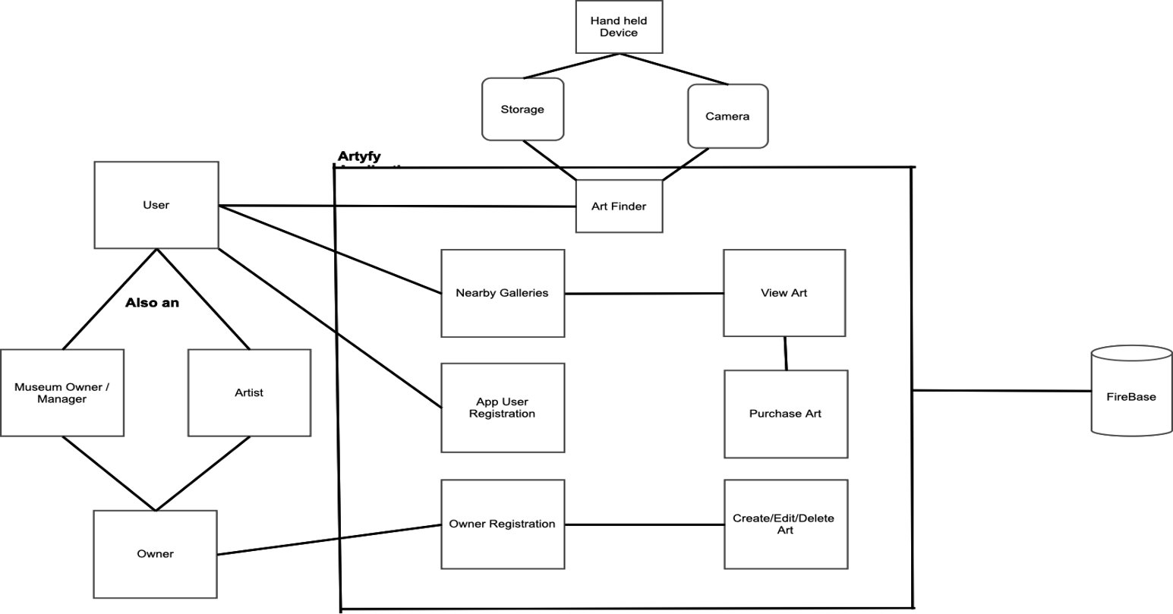
Architecture Diagram

Slide 11
Technical Aspects
Supported Platforms: Android 8+​
Front-end : XML​
Back-end : Java​
Database: FIREBASE​
Development Tools: Android Studio​

Slide 12
SPECIFICATIONS
User Registration and logins
Most of the applications require registration and logins to identify and classify the users. In our application the target users classify as users, art gallery owners and artists to access their respective interfaces. In the process of registration, the details of users, gallery owners and artists are stored in firebase database and the information which exists in the firebase database are used for authentication purposes during user logins.
List of nearby museums and art galleries
Now-a-days users are highly considering the near-by feature in comparison. This feature is highly recommended when people are travelling to new places or residing in unknow places. In this feature, the users can be able to find nearby art galleries and museums from their respective location. Based on the distance between the user’s location and art gallery location, the application fetches the details of art galleries and museums which are nearer. The users get the output display of nearby art galleries and museums in the order based on their respective location.
Registration of art gallery owner and artists
Whenever, a user chooses to be an art gallery owner or artists, they need to feed their museum details to the system to present their arts through the application. Basing on inputs details which was given by art gallery owner or artists, the details are automatically saved into museums list or artists list and visible to all the users, artists and art gallery owners.

Slide 13
Specify Add, Edit and Delete art
We would like to implement all the mentioned transactions related to Artwork such that user can easily get UI to perform such operations. All the information related to artwork is fetched from the firebase database through specific interfaces assigned for the tasks only, this helps user to add for any new artwork, remove and edit information for existing artwork. After receiving information from user, the application start processing the contents. For add operation, application receive details and transfers it into relevant interface to save it further to database after applying appropriate logic. For update, delete and fetch operations, similarly application receives information and apply relevant logic to make the data sufficient to be saved in the database, which can be used in future.
View Arts and Paintings
This function will allow the users to view the arts and paintings which the art gallery owners uploaded. The details of arts provided by the art gallery owners are stored in the firebase database respective to their art galleries. In the listing of art galleries based on the nearby feature, the users can view all the arts and paintings in their respective art galleries. The user can view the details of art images, artist name, art description and art price in the respective art galleries which was maintained by art gallery owners.
List of arts based on artists
This feature provides the list of arts which was managed by the artist. After the artists registration, the artist have access to add their own arts, modify and delete the existing art which was present in the database. The arts which manages by artist are visible to all users, artists and art gallery owners.

Slide 14
Payment feature
This feature is only available when the art gallery owner or artists wants to sell their art item by selecting the sell option then user will have access to purchase that particular art. The art gallery owners and artist have access to modify the sell option which results in the offerings of their art items to the users.
Art Finder feature
The users use the art finder tool by upload an image from your directory to the application. In a comparable art feature, we send this image to our machine learning method to get the details of art which was uploaded. This function is incredibly useful for art enthusiasts because it allows them to upload a picture at any moment and acquire more information about it in seconds.

Slide 15
SDLC Model used for Development
The SDLC model that is used for development of project is Agile. In Agile methodology, the prime objective is to satisfy the customer’s need through an environment of transparency in communication, collective responsibility, and continuous progress. There are so many frameworks available to implement Agile such as Scrum, Kanban, etc., but we have used Scrum for Artyfy.
Scrum Framework
It is an agile methodology in which products are developed iteratively. You can focus on the product development work if you are using a right tool which has the power to manage all other tasks. There are some integral parts of scrum methodology which includes Planning, sprints, standups, and retrospectives.

Slide 16
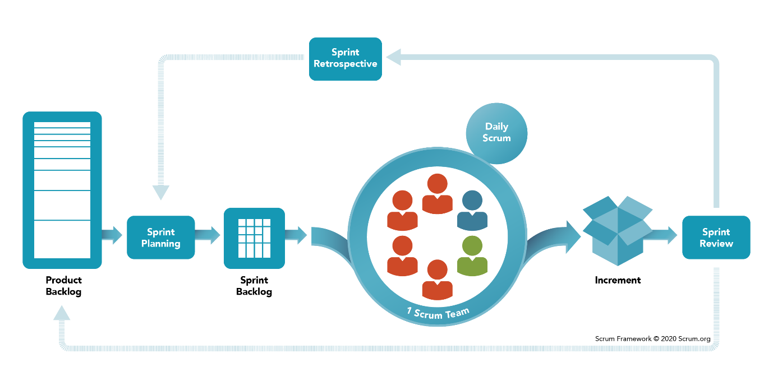
Scrum Framework
The processes included in Scrum Framework are:
Sprint Planning
Scrum Meetings
Sprint Review
Sprint Retrospective
Backlogs (Sprint/Product)

Slide 17
How is Scrum Framework implemented in Artyfy?
During Sprint Planning, the major tasks in the sprint are divided into sub-tasks and are distributed among team members. Each team members can track the record of their task from the scrum board or JIRA board for the overall progress of the application.
Information about each task is shared with each team member during the daily scrum meetings.
If anything can be picked from the backlogs, then it’s added to sprint tasks.
After the sprint gets over, a sprint review is done so as to track the overall progress of the product till the sprint.
If there is any task that is left uncompleted, or any bug found during the sprint completion then those tasks are put in the backlogs.
A sprint report is to be made for the progress.
In the end, a sprint retrospective meeting is conducted and the report for that is created for submission.

Slide 18
WHAT WENT WELL AND WHAT DIDN’T
Initially as all of us were in different parts of the world we were facing issues during the project kick-off and initial tasks.
All of us were novice in android development. So have to dedicate time for learning android and took more than the estimated effort.
Later on, we completed everything as estimated and every milestone went out very well.
We also faced issues for estimating efforts and placing screens for the flow of the project, however, we have improved the flow by improving the overall feature in the next sprints.

Slide 19
Test Planning
Name | Artyfy
Description | This app offers a list of surrounding institutions as well as a total number of artists who have registered to present their artwork and sculptures to art lovers and the general public. This mobile application reduces the barriers that limit people's access to art by allowing them to enjoy the work of various artists or creative locations.
Test Objective | Examine the product's stability, as well as its functions and features. The user's judgement of product stability, which covers quality, performance, dependability, and functionality of product themes, is known as stability acceptance.

Slide 20

Testing refers to the process of evaluating an app. This procedure is beneficial in preventing numerous problems that may arise during the software development process, as well as adding value to the product by ensuring it fulfils all of the client's requirements.
As an app is being constructed, the most important aspect is its design, which must be user-friendly. After all, application is all about the user, and if they find it difficult to use, they will not utilize it, resulting in a low conversion rate. Then, to verify that all of the functions are working properly, proper testing is required, which aids in the elimination of any bugs or faults that may arise during use. It is critical to make certain of this.

Slide 21
It verifies a number of things, including: Application testing also allows you to assess the usability, functionality, performance, compatibility, and security of a website or app. These are important considerations for any app.
Improves usability: The usability is critical, as is addressing the risk factors that come with it, both of which can be accomplished.
It ensures that transactions are completed on time: Testing ensures that each and every page on the application is carefully tested and verified to ensure that all transactions are completed successfully. This also aids in determining whether or not the app is ready for usage by the customer.
Examines functionality and compatibility in relation to load: To ensure that client requirements are met flawlessly, we must ensure that all of the functions available on tare properly functioning under a variety of load conditions. Organizations must also ensure that their app is compatible with a variety of browsers and systems. All of these concerns can be addressed through testing, which also ensures compatibility and decent performance under severe loads.
Reduces the risk of change: It is also easy to ensure that the integration of new modifications does not damage the performance or produce any unintended issues by conducting testing.
How Testing Can Be Beneficial?

Slide 22

Following Risks Can Be Prevented By Performing Testing?
Slow application loading
Weak search functionality
Unavailability of item
Could not sign in
Wrong artist details
Wrong display details

Slide 23

Important Test Cases
As a result, test cases are primarily scripted/non-scripted scenarios used to verify the various functionalities of an application. And we've included a complete checklist as well as key test cases that an application testing team should focus on.

Slide 24
1. In general
It is critical that the general Test cases for app are carefully written and thorough. Even the tiniest details, such as the home screen interaction quality, how smooth the navigation across product categories is, or whether the product picture enlarges upon clicks, and so on, require a great deal of care. The following are some of the general tests that must be run on the website:
Whether or not the links are routed to the right art/category pages
Whether the art, category name, art description, and artist details are all clearly visible.
Whether all category/museum pages include a relevant art that is specifically listed for the category/museum.
S.No | Action | Input | Expected Output | Actual Output
1. | Whether or not the links are routed to the right art/category pages | Click on any art picture | Able to direct to the clicked art details | Directed correctly
2. | Whether the art, category name, art description, and artist details are all clearly visible | Click on any art picture | All details displayed are correct and accurate | Details were correct and accurate
3. | Whether all category/museum pages include a relevant art that is specifically listed for the category/museum | Click on any particular gallery and match the art with caategory | Art should be displayed in its category only | It was displayed correctly

Slide 25
2. Art Details
A art display page's testing is a critical part. Testing verifies that the arts listed are fully functional. Important information such as painting details, artist details and art specification can be found on the display page, and it is critical to ensure that all of this information is displayed correctly every time a consumer logs into the app. It is critical to test the following:
Is the details of the art displayed?
Is the image/images displayed correctly?
Is there any information about museum where it can be found?
S.No | Action | Input | Expected Output | Actual Output
1. | Is the search available based on the painting name, artist name, or other criteria | Search for a particular art, artist or museum | Should display the correct search or closely matched results | Displayed correctly
2. | Sort items based on artist, category, and other factors should be sorted well | Sort using any one of the option | Sorting should be correct and accurate | It was correct and accurate
3. | If the results are on numerous pages, whether there are alternatives to navigate between them | Click on back button after viewing an art | Should be taken back to the previous tab | It was displayed correctly

Slide 26
3. Hardware and Software Compatibility
Measure hardware compatibility and performance utilizing required devices by running a hardware test against a variety of phone and tablet interfaces.
Check for compatibility across all android versions.
Check performance for all android versions
S.No | Action | Input | Expected Output | Actual Output
1. | Measure hardware compatibility and performance utilizing required devices by running a hardware test against a variety of phone and tablet interfaces | To check on variety of phone and tablet interfaces | Should work well for all devices | Worked well
2. | Check for compatibility across all android versions | To check compatibility for all android versions | Should operate well on all versions | Operated well on all versions
3. | Check performance for all android versions | To check performance on android versions | Should perform well and same for all android versions | Performed well for all versions

Slide 27

Quality Assurance
Scrum is an agile framework that is designed to offer value to the client throughout the project's development. It is adaptable, rapid, flexible, and effective.
Thus the problem of compatibility, slow working system are easily solved.
SCRUM principles are consistent with the agile manifesto which is used to guide development activities within a process that incorporates 5 framework activities: requirements, analysis, design, evolution and delivery. Scrum used the set of software process patterns that proven effective for the projects with tight timeline, changing requirements and business criticality.

Slide 28

Risk Assurance And Handling
Containing and mitigating risk is what risk management entails. To begin, you must first identify and plan. Then, when a risk develops, be ready to act, drawing on the experience and knowledge of the entire team to minimize the project's impact.

Slide 29


1. Privacy and Security
Determine where personal (phone number, email address) or sensitive (payment and password) information is needed. When storing this type of information, security testing should be a top priority to prevent leaks, hacks, and breaches from tarnishing reputation. We will ensure that the user’s privacy and security is not at threat by all possible means.
2. Compatibility
Application should be tested on variety of browsers and devices during exploratory testing when it undergoes a code update. Application versions come in a variety of setups, therefore you should test it on all of them. Before launching the application will ensure it is compatible with all the versions of android and tablets.

Slide 30


3. System Reliability
An application must avoid failures such as ISP server crashes, online payment system faults, and plugin bugs. All of these difficulties have the potential to bring the entire application crashing down, which would have a significant impact on consumer satisfaction. The best way to overcome this problem would be to run the application in all environment and even going through the worst-case scenario and have the solution ready if it occurs.
4. Data Correctness
The details mentioned in the application should be correct and precise. The false data can lead to losing the trust of user. So the information regarding the art, artist and nearby museum should be double verified. The data entered and the data would be entered by the artist would be double verified and then uploaded in order to maintain the data integrity.

Slide 31
LIVE DEMO

Slide 32
FUTURE SCOPE
This application is now limited to android, in future we will also implement it for IOS.
We want to improve our UI for better user interaction with high quality aesthetics.
Improvement of Art Finder algorithm to serve better purpose.
Expanding to multi nature project for interior designers, indigenous makeup artists, fashion designers and many more whose things can be categorized as arts.
We can further provide options as
premium items to buy & view and featured places.
users are provided with subscription who can have individual preferences.
charging fee for featuring a painting or art and bidding the art online.

Slide 33
THANK YOU

